Slide 1


NETWORK MANAGEMENT INTERFACES
NGOApps
Erik Polzin
Kane Gibson

Slide 2
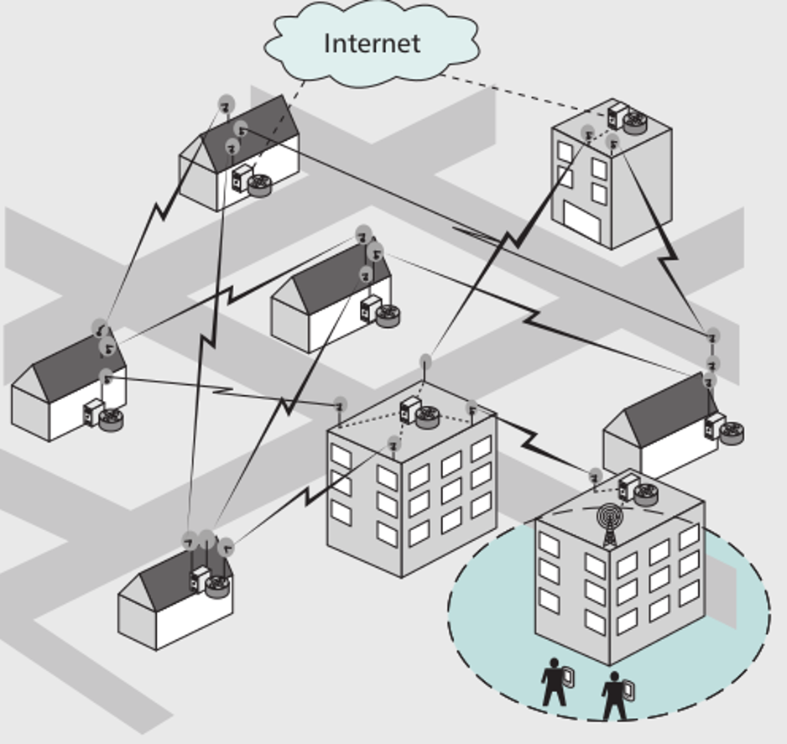
COMMUNITY WIRELESS NETWORKS
Wirelessly connected routers (‘nodes’)
Grows organically without prior planning
Self-configurable, health-healing and self-tuning
Backbone and client nodes
Optional gateway

Slide 3

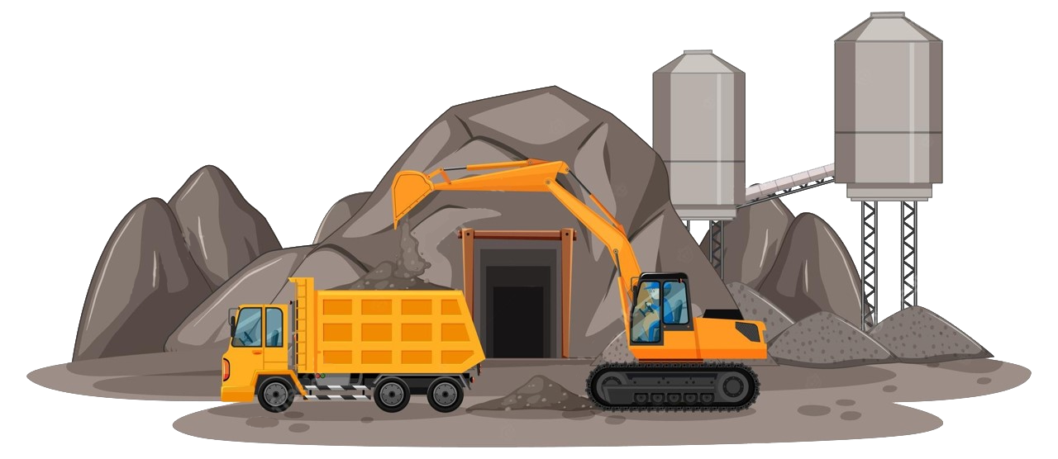

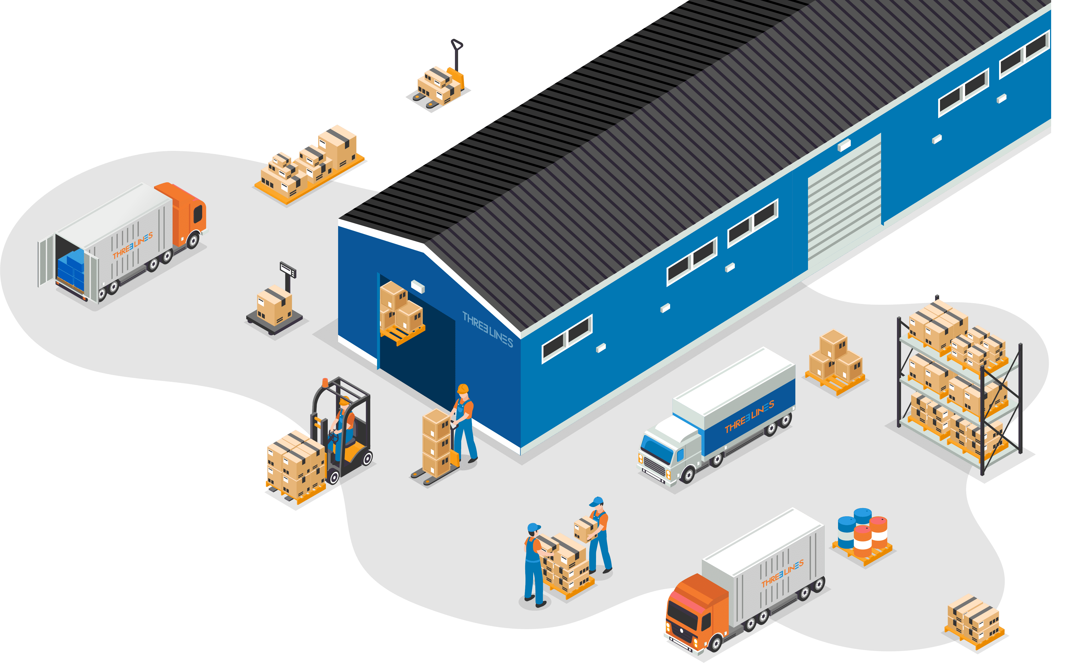

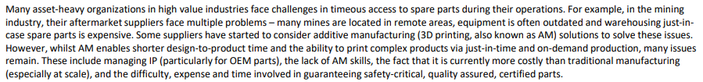
TIMEOUS ACCESS TO SPARE PARTS
THE SITUATION OF CONCERN
Located in remote areas
Limited storage space
Outdated equipment in warehouses

Slide 5

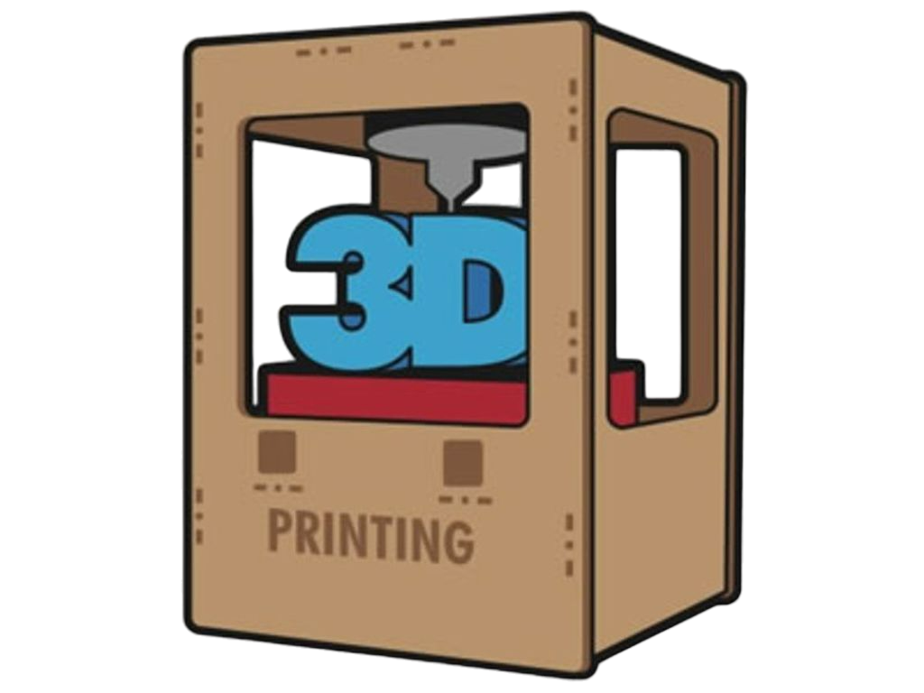
SITUATION OF CONCERN
OPPORTUNITY
How might we develop a solution that would enable on-demand 3D printing of spare parts by either the high value industries themselves, or by the original equipment manufacturers (OEMs), whilst ensuring IP protection and certified, safety-critical quality parts?

Slide 6






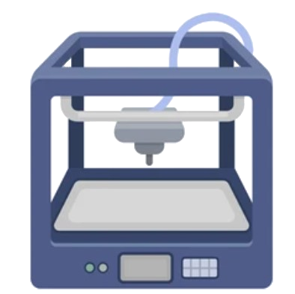









THE PROCESS OF 3D PRINTING SPARE PARTS
SERVICE TO THE MINES
BUY
PART BREAKS
ORDER PART
PRINT PART
FINE-TUNING
DELIVERY

Slide 7
THE PROCESS OF 3D PRINTING SPARE PARTS
SERVICE TO THE MINES
BUY
PART BREAKS
ORDER PART
PRINT PART
FINE-TUNING
DELIVERY

Slide 8
THE INITIAL PROCESS
Before we can provide the service of 3D printing on demand to the mines, we need to go through this process
CAD SCHEMATICS BLOCKCHAIN
DESIGN ENGINEERING
QUALITY ASSURANCE
AGREEMENT

Slide 9
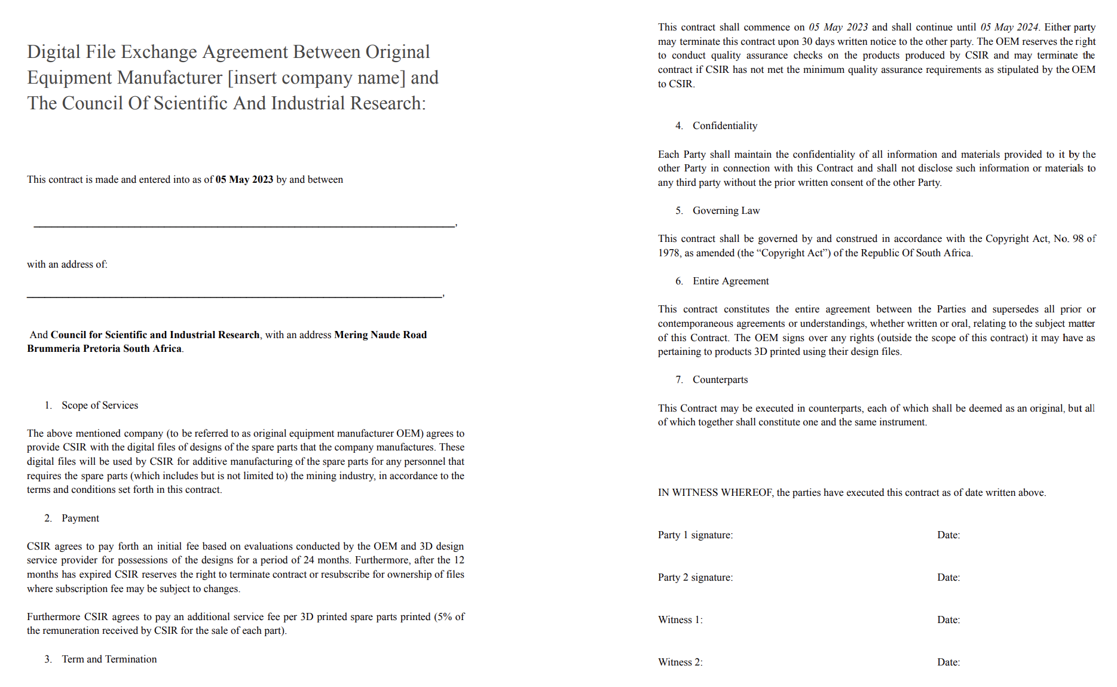
AGREEMENT

Slide 10
AGREEMENT

Slide 11
AGREEMENT

Slide 12
CAD SCHEMATICS BLOCKCHAIN
DESIGN ENGINEERING
QUALITY ASSURANCE
AGREEMENT

Slide 13

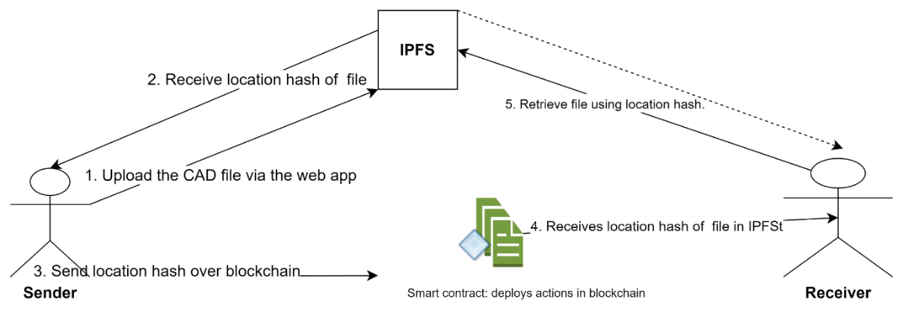
CAD SCHEMATICS BLOCKCHAIN
Decentralized system with the Ethereum blockchain, Smart Contract and Interplanetary File System (IPFS).

Slide 14
CAD SCHEMATICS BLOCKCHAIN
DESIGN ENGINEERING
QUALITY ASSURANCE
AGREEMENT

Slide 15

DESIGN ENGINEERING

Slide 16
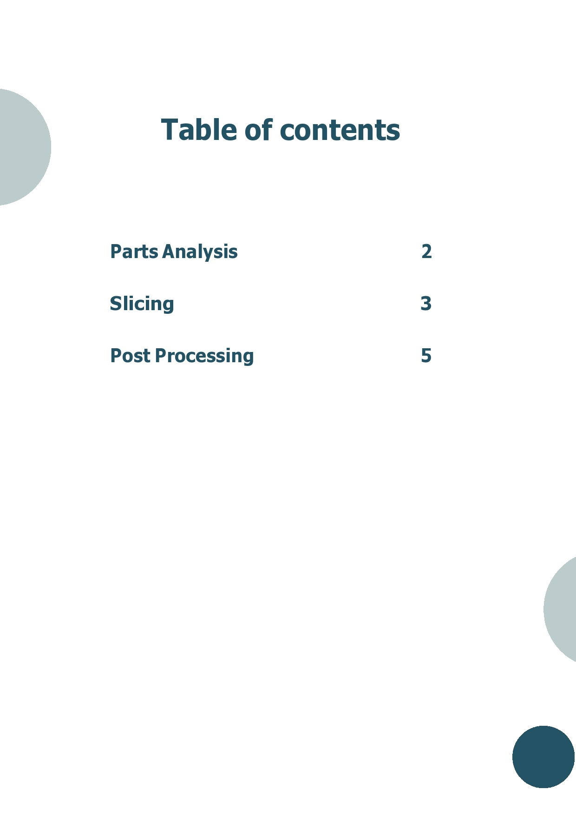
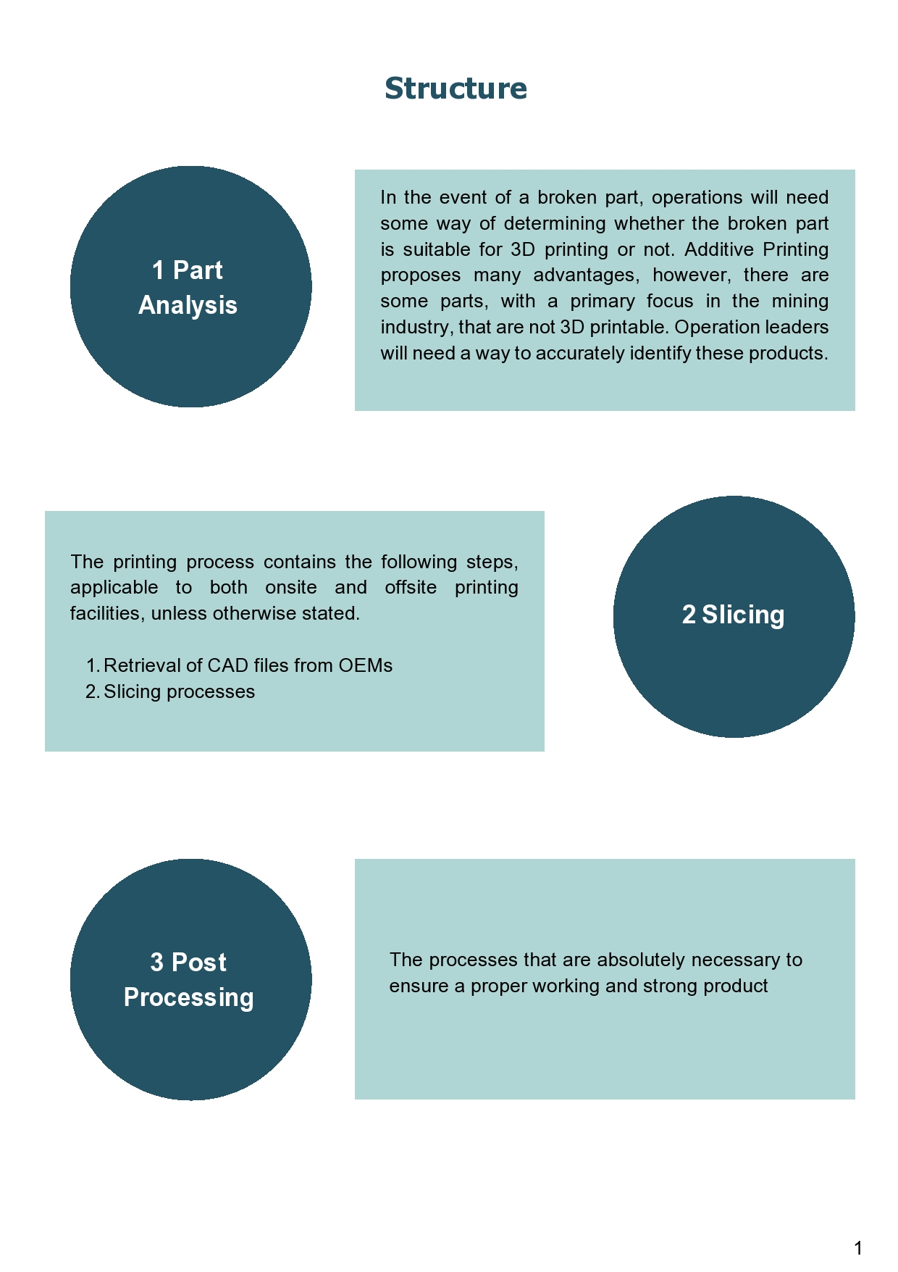

Slide 17
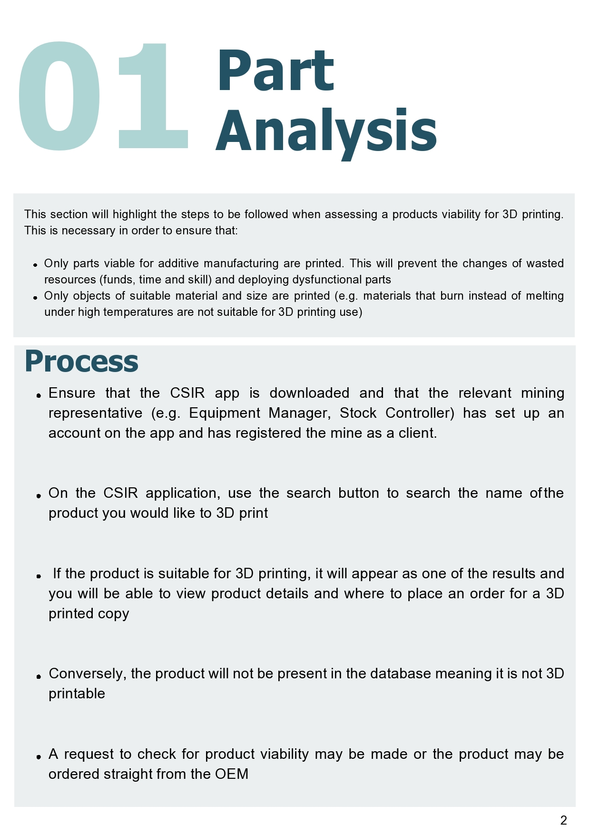
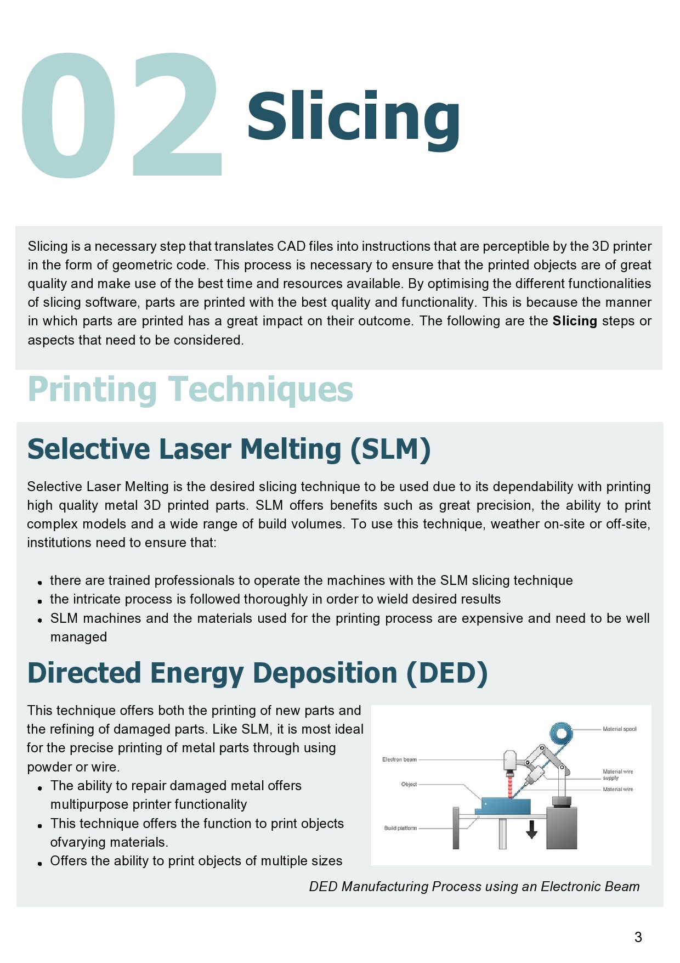

Slide 18
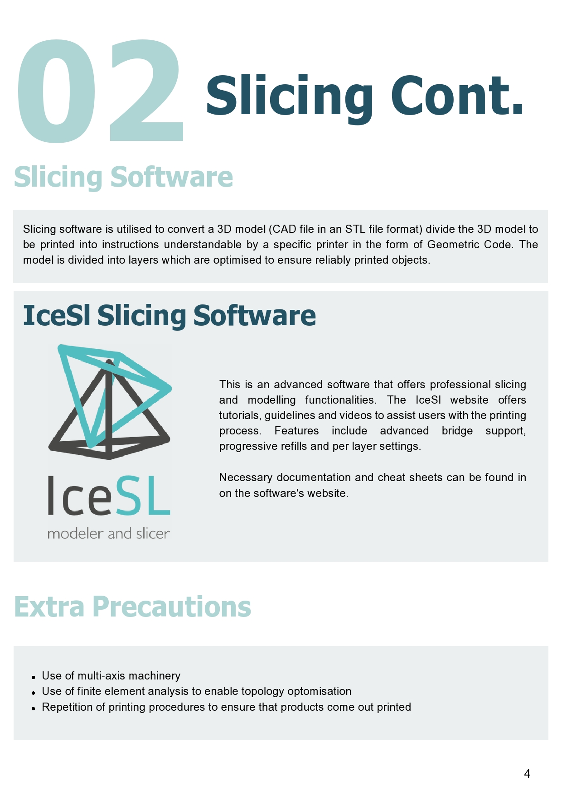
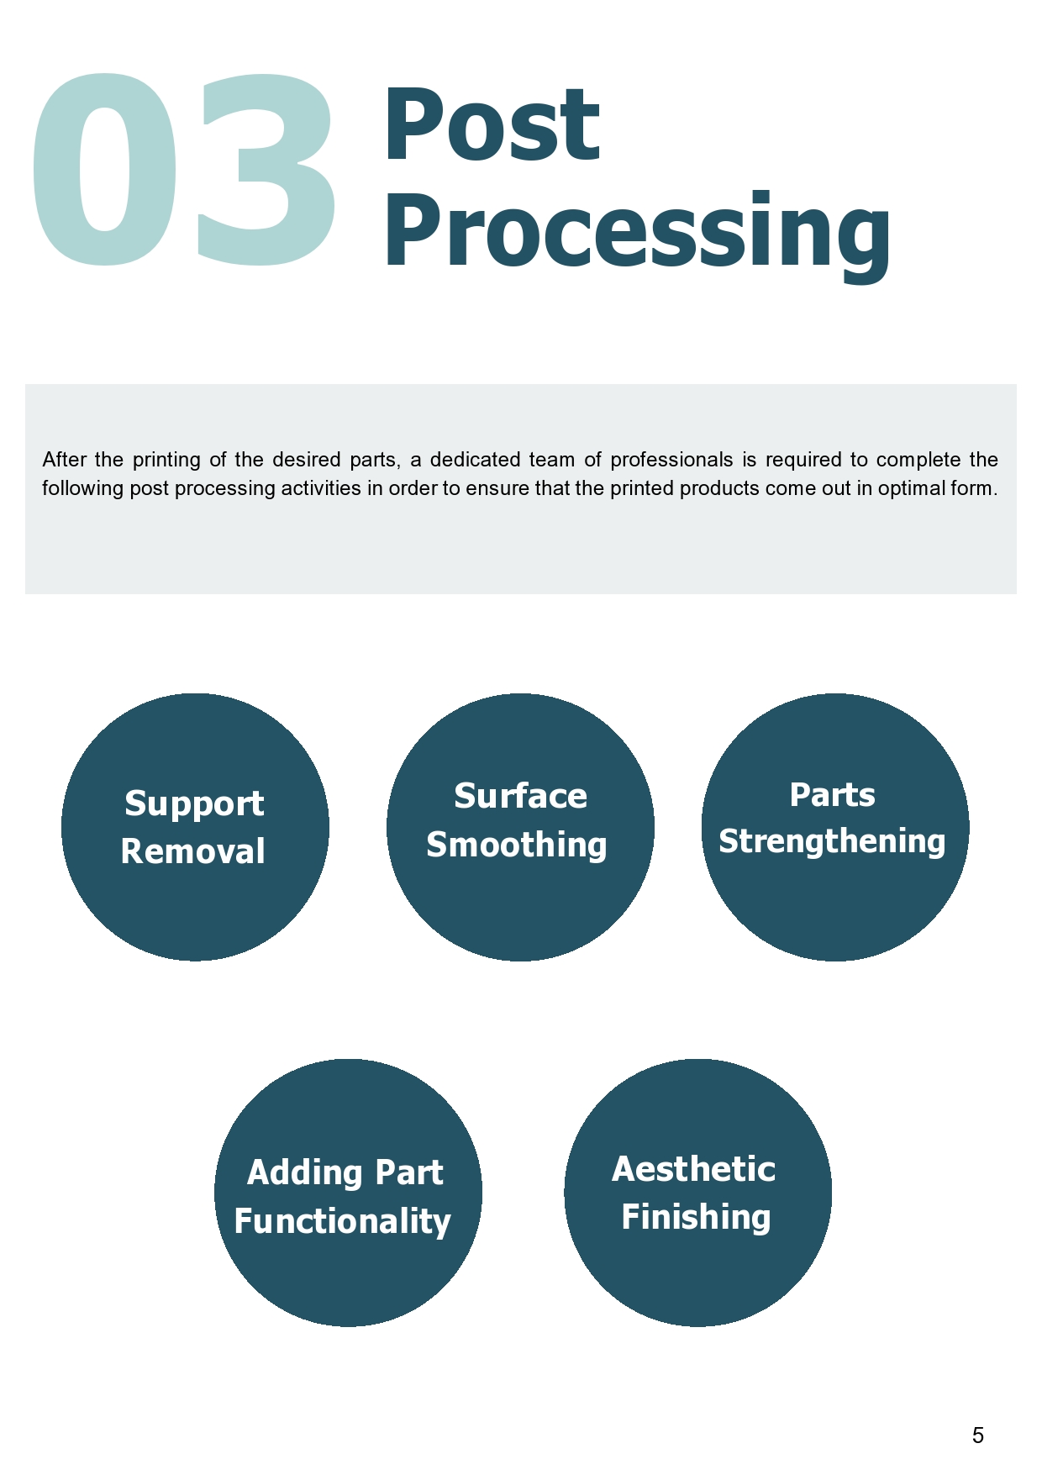
DESIGN ENGINEERING

Slide 19
CAD SCHEMATICS BLOCKCHAIN
DESIGN ENGINEERING
QUALITY ASSURANCE
AGREEMENT

Slide 20



QUALITY ASSURANCE
Strength Testing
Before we can provide the service of 3D printing on demand to the mines, we need to make sure that the 3D printed spare parts are up to standard. The following tests will be performed to quality assure the parts:
Assesses the strength or durability of a material.
Thermal Testing
Measures how a material responds to changes in temperature.
Materials Testing
Looks at how different materials react to different pressures and weights.

Slide 21
THE INITIAL PROCESS
Before we can provide the service of 3D printing on demand to the mines, we need to go through this process
CAD SCHEMATICS BLOCKCHAIN
DESIGN ENGINEERING
QUALITY ASSURANCE
AGREEMENT

Slide 22
THE PROCESS OF 3D PRINTING SPARE PARTS
SERVICE TO THE MINES
BUY
PART BREAKS
ORDER PART
PRINT PART
FINE-TUNING
DELIVERY

Slide 23
THE PROCESS OF 3D PRINTING SPARE PARTS
SERVICE TO THE MINES
BUY
PART BREAKS
ORDER PART
PRINT PART
FINE-TUNING
DELIVERY

Slide 24



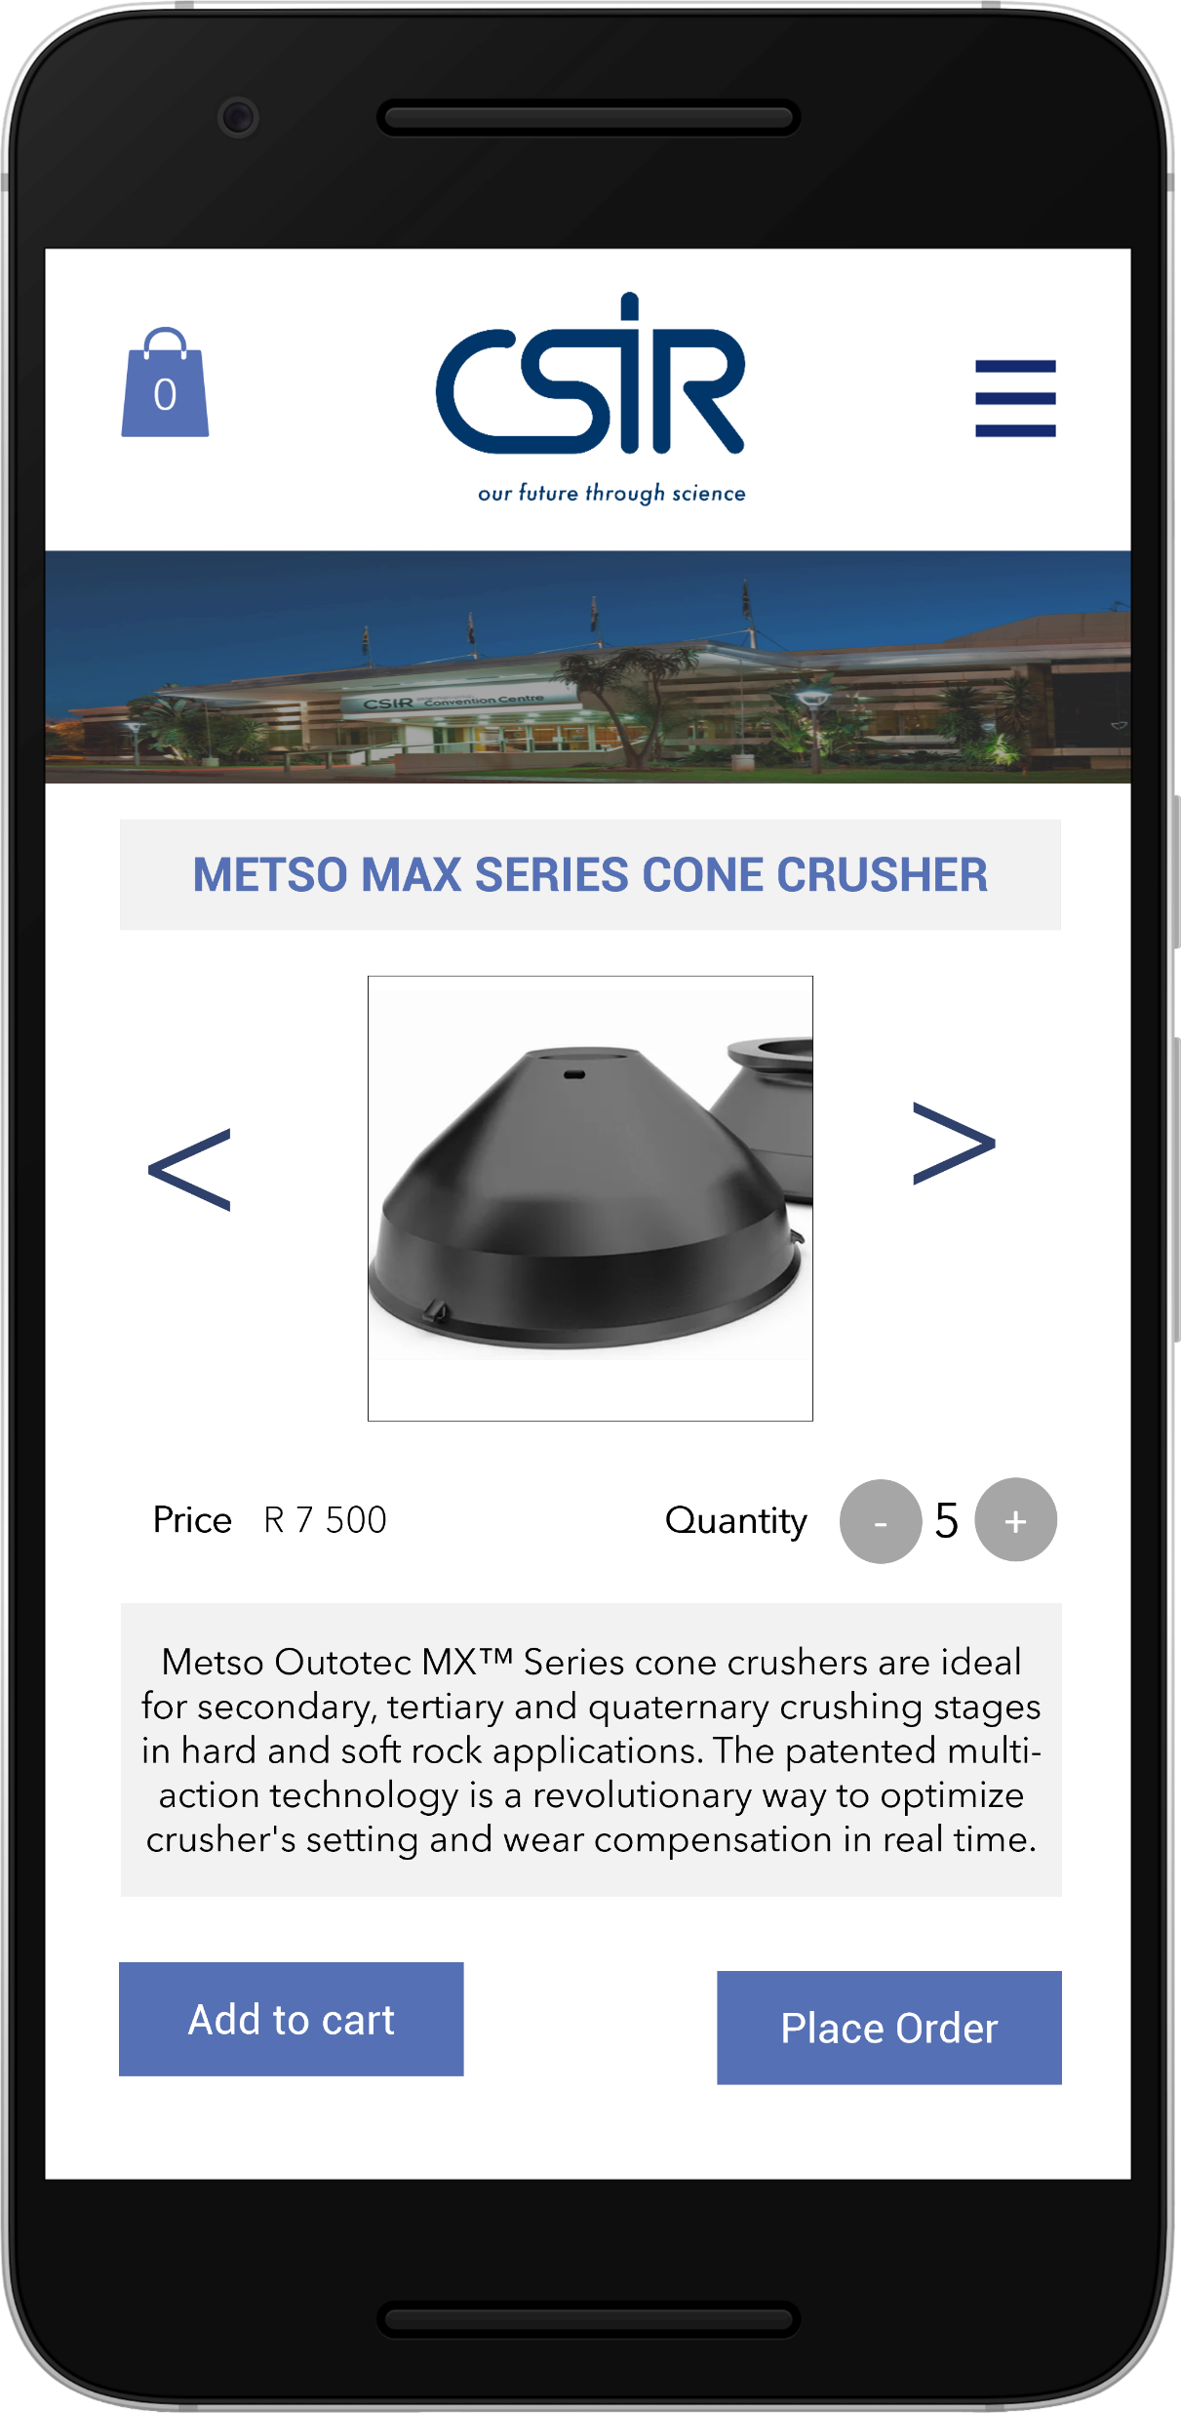


ORDERING SOLUTION
APPLICATION WIREFRAMES

Slide 25
ORDERING SOLUTION
APPLICATION WIREFRAMES

Slide 26
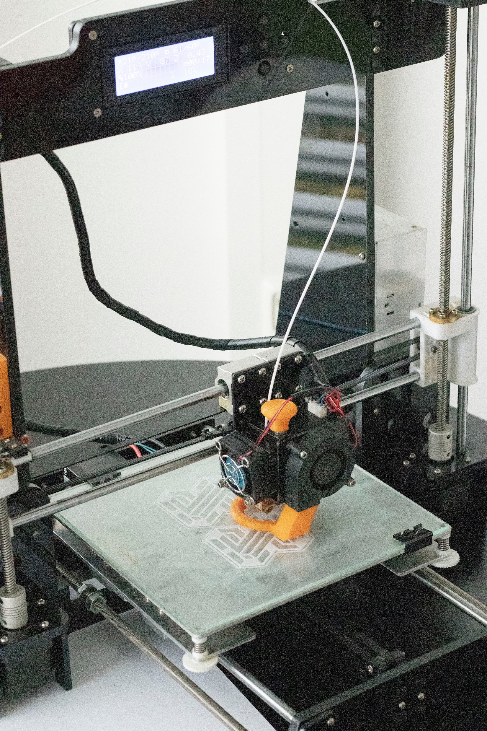

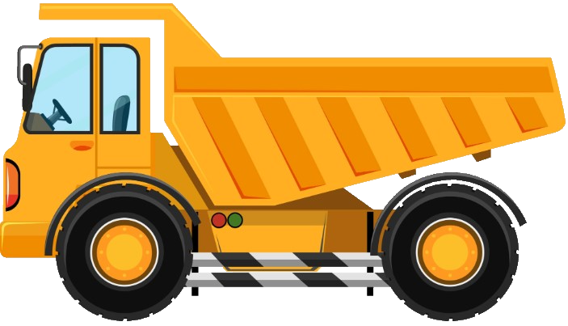
PRINTING PREMISES
Using historical data and analyses of the particular mining project, estimate the spare parts that will most likely be needed.
Supply the printers capable of printing these spare parts. Supply the materials these spare parts are made of.
90
Print the most likely required spare parts on-site (no transportation delays). Print the remaining parts off-site. Possible that 90% of spare parts is dealt with on-site.
10

Slide 27
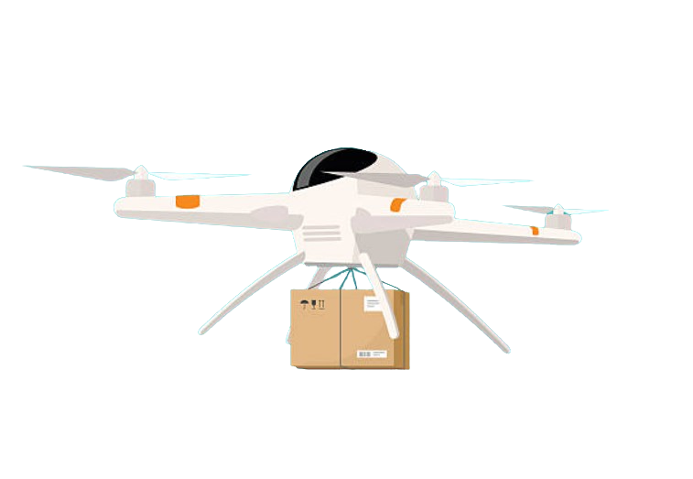
DELIVERY SOLUTION
DRONES
Drones can be used to transport smaller spare parts from the printing premises to the mines.
The weight of the spare part that can be carried by the drone depends on the drone's payload capacity and size
Drones offer an efficient and fuel-effective method of transporting spare parts

Slide 28
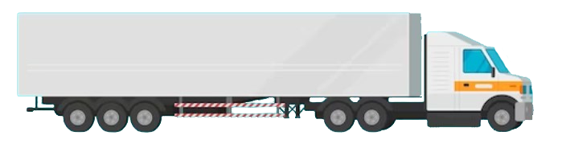
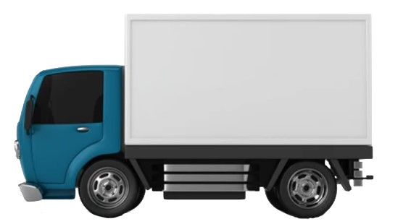
DELIVERY SOLUTION
TRUCKS
Trucks can be used to transport larger spare parts from the printing premises to the mines.
The maximum weight of the part is dependent on the size of the truck that will be used and should be decided on before transit.
Based on the research we've done; a hybrid implementation of trucks and drones would be an ideal solution for transporting spare parts.

Slide 29
3D PRINTING ON DEMAND
THE ENTIRE PROCESS
CAD SCHEMATICS BLOCKCHAIN
DESIGN ENGINEERING
QUALITY ASSURANCE
AGREEMENT
BUY
PART BREAKS
ORDER PART
PRINT PART
FINE-TUNING
DELIVERY

